Slide 1

Subject Code
PT I - INTERDISCIPLINARY PROJECT
PORTFOLIO APP WEBSITE
1. Sanjay J [ Reg.No. : 42611123 ]
2. Sarveswaran A [ Reg.No. : 42611127 ]
Internal Guide
Dr. R. Sathya Bama, M.E., Ph.D.,

Slide 2
PRESENTATION OUTLINE
COURSE CERTIFICATE
ABSTRACT
OBJECTIVES
SYSTEM ARCHITECTURE
HARWARE & SOFTWARE REQUIREMENTS
FRONT END DEVELOPMENT
BACK END DEVELOPMENT
RESULTS & DISCUSSIONS
RESULTS SNAPSHOTS
REFERENCES

Slide 3
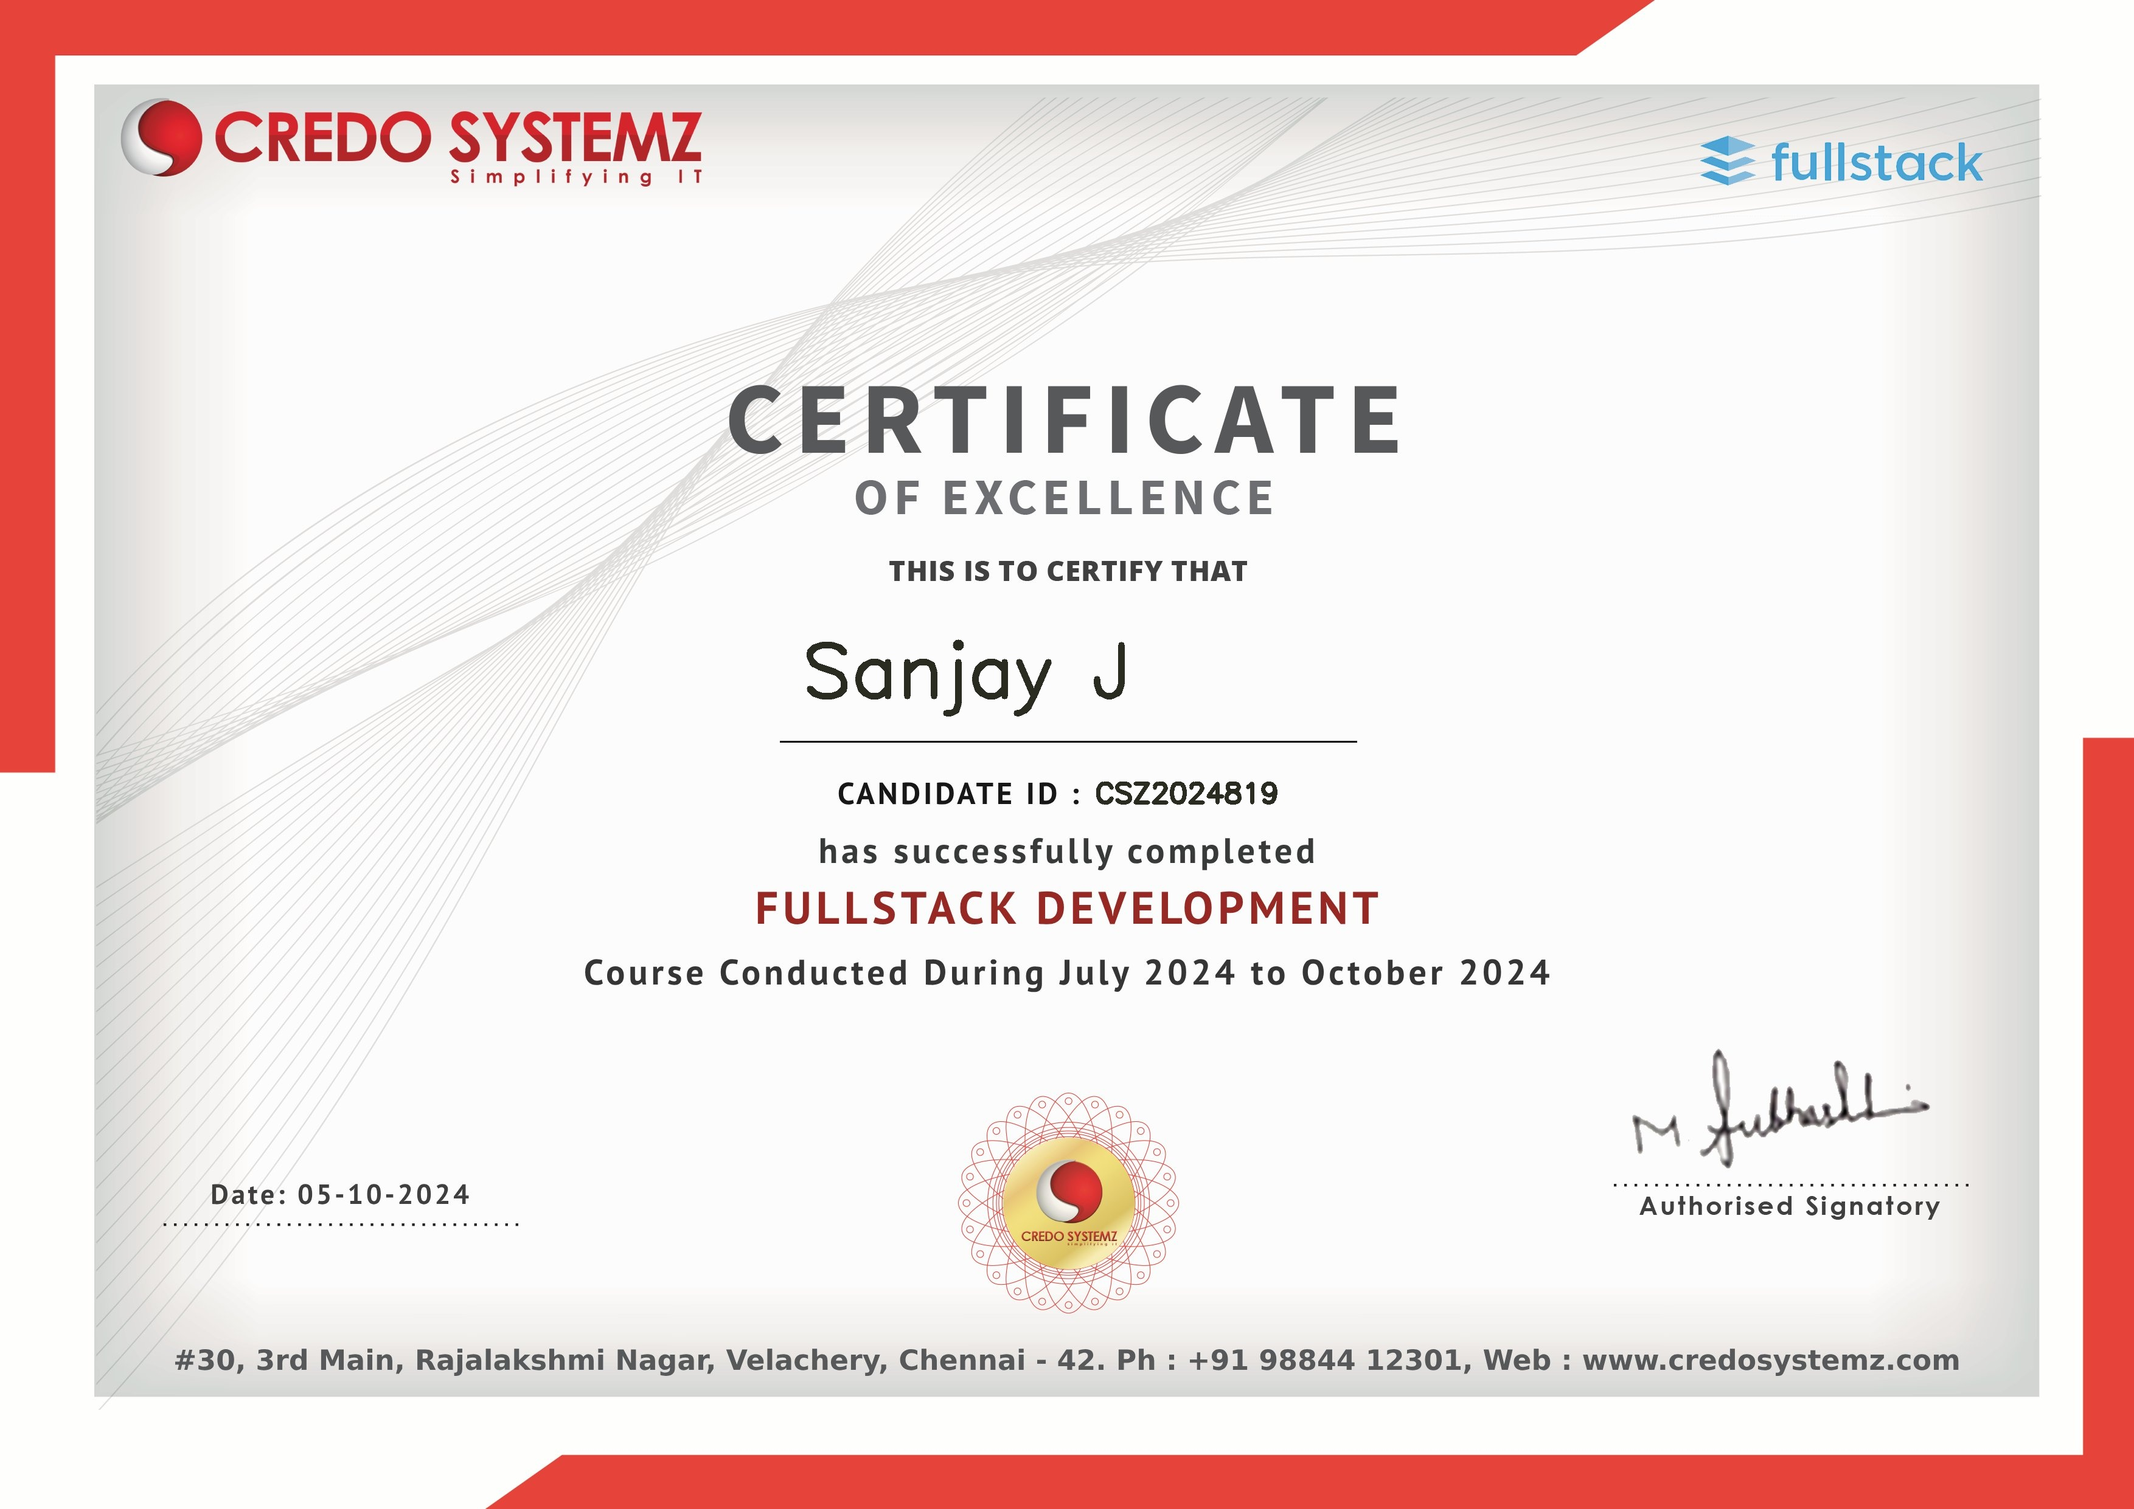
COURSE CERTIFICATE

Slide 4
ABSTRACT
In today’s digital era, a portfolio website is crucial for individuals to showcase their professional work and accomplishments. Traditional resumes often fail to convey the depth of a person’s skills and achievements. The Portfolio Web Application is a dynamic and responsive website developed using Angular for the front-end and Node.js for the back-end, designed to showcase the developer's skills, projects, and professional experience.
The application includes well-structured sections such as "Home," "Portfolio," "Resume," and "Contact," providing a comprehensive view of the developer's capabilities. The frontend of the website is designed using Angular, a powerful JavaScript framework that enhances the user experience through two-way data binding, component-based architecture, and single-page application features.

Slide 5
OBJECTIVES
The main objective is to create a dynamic platform that allows users to easily add, edit, and delete posts, ensuring their portfolios are always up to date.
This project focuses on the development of a professional portfolio website using cutting-edge web technologies like Angular, Node.js, Bootstrap, and Git with the objective of creating a fully responsive, user-friendly, and visually appealing personal portfolio to showcase my skills, experience, and projects.
Existing platforms often lack customization and interactivity, making it challenging for professionals to find suitable solutions.
The proposed project will utilize modern web development techniques, such as React.js for interactivity, Node.js for server-side logic, and Mongo DB for data storage, empowering users to take full control of their portfolios.

Slide 6
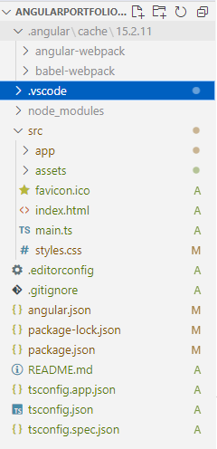
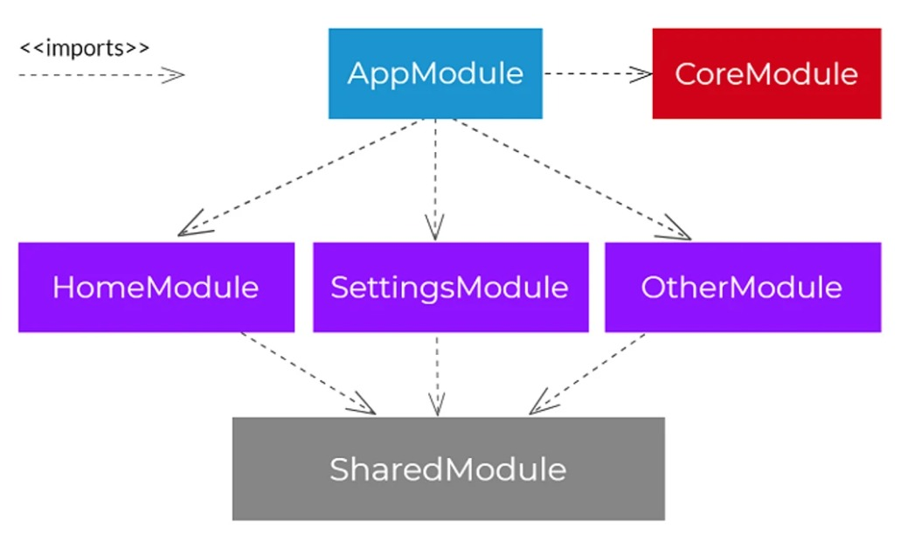
SYSTEM ARCHITECTURE

Slide 7
HARDWARE AND SOFTWARE REQUIREMENTS
Hardware Requirements
CPU: Multi-core processor (Intel Core i7/AMD Ryzen 7 or higher) .
GPU: Minimum 6 GB VRAM GPU (NVIDIA GTX 1660 Super, RTX 2060
RAM: Minimum 8 GB, recommended 16 GB for handling multiple AI requests.
Storage: At least 256 GB SSD for faster data access.
Software Requirements
HTML5: Defines the structure and layout of the web interface.
CSS3: Styles the front-end to ensure a responsive design.
Operating System: Windows, macOS, or Linux
Node.js: Version 14.x or later for back-end development
Angular CLI: Latest version for front-end development

Slide 8
FRONT END DEVELOPMENT
Angular Framework
Component-based architecture for building dynamic UIs.
Two-way data binding for real-time updates.
TypeScript for enhanced code structure and maintainability.
Responsive Design
Bootstrap for mobile-first, responsive layout.
Adaptive design ensuring compatibility across different devices and screen sizes.

Slide 9
Key Sections Implemented
Home, Portfolio, Resume, Contact pages for a comprehensive view of skills and experience.
User-friendly navigation and smooth transitions.
Custom Styling
CSS and SCSS for fine-tuned, personalized styling.
Modern and clean design tailored to the developer’s branding.
Real-Time Updates
Data dynamically rendered on the UI based on API responses.
Changes in the backend (admin panel) immediately reflected on the frontend.

Slide 10
➢BACK END DEVELOPMENT
Node.js Overview
JavaScript runtime for server-side development.
Non-blocking, event-driven architecture.
Supports scalable, high-performance applications.
RESTful API Creation
API endpoints for managing portfolio content (projects, user data).
JSON format for seamless communication with Angular frontend.

Slide 11
User Authentication
Secure admin access using JWT (JSON Web Token).
Protects routes for content management.
Database Integration
MySQL for storing portfolio data (user info, projects).
Implements CRUD operations (Create, Read, Update, Delete).
Security Measures
HTTPS for secure communication.
Input validation to prevent vulnerabilities.

Slide 12
RESULTS AND DISCUSSION
This chapter presents the outcomes from the development of the Portfolio Web Application, highlighting its performance, user feedback, and impact on developers' professional representation.
The application successfully meets its functional requirements, featuring a dynamic content management system that allows for efficient portfolio updates through a user-friendly admin interface.
Moreover, the Portfolio Web Application enhances personal branding by allowing developers to showcase their skills and projects uniquely, significantly aiding in their visibility in a competitive market.
Future enhancements could include advanced analytics and additional customization options based on user feedback, ensuring the application evolves to meet the changing needs of its users.
Overall, the project represents a successful integration of modern web technologies, providing developers with a valuable tool for professional growth and representation.

Slide 13
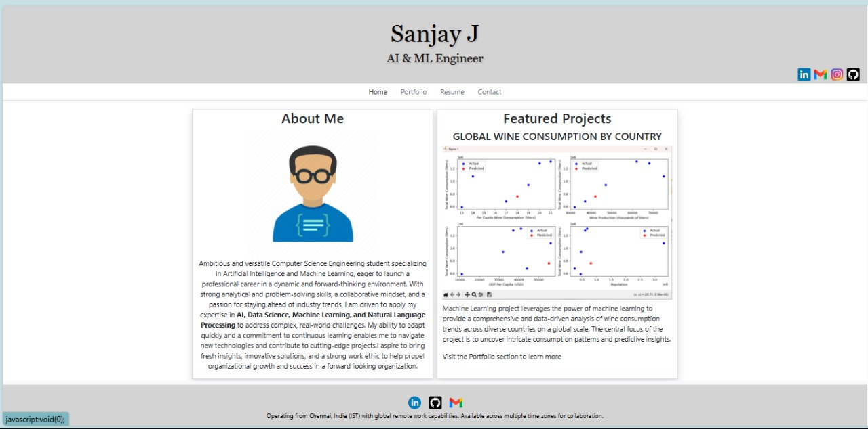
RESULTS SNAPSHOTS

Slide 14
REFERENCES
1. Angular Team. Angular CLI Documentation. Available online: https://angular.io/cli .
2.Node.js Foundation. Node.js Documentation. Available online: https://nodejs.org/en/docs/
3. Lecheta, F. Building Front-End Web Applications with Angular: Concepts and Practices. In Proceedings of the International Conference on Web Technologies, 2020, pp. 100-112. 4. Nguyen, T., & Ton, L. Server-Side JavaScript with Node.js: Applications and Security. In Journal of Web Engineering, 2021, 19(3), pp. 215-232.
5. Smith, P., & Davis, K. Implementing JWT Authentication for Secure Web Applications. In Journal of Web Development and Design, 2021, 9(2), pp. 45-58.

Slide 15

PORTFOLIO APP WEBSITE

